Slide 1

Toque’d
Mike McDonald
CSSE490 Final Project
11/9/2012

Slide 2
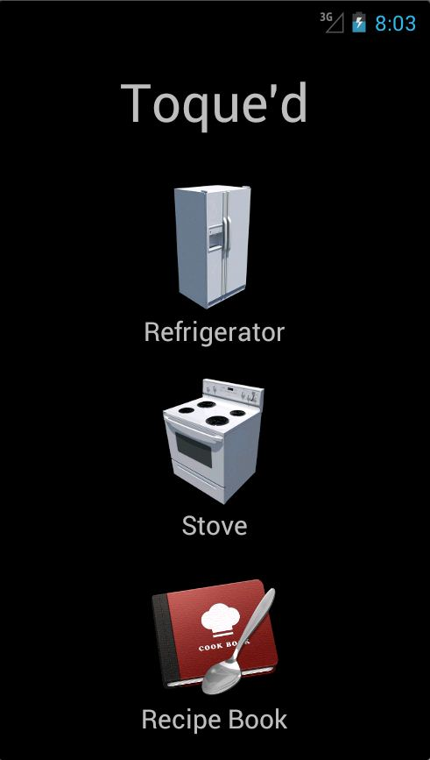
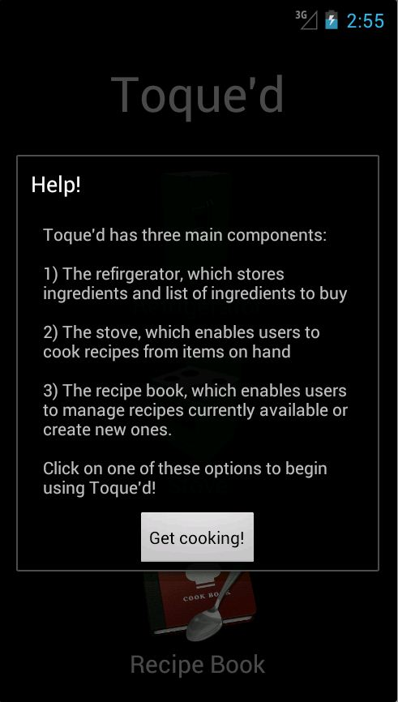
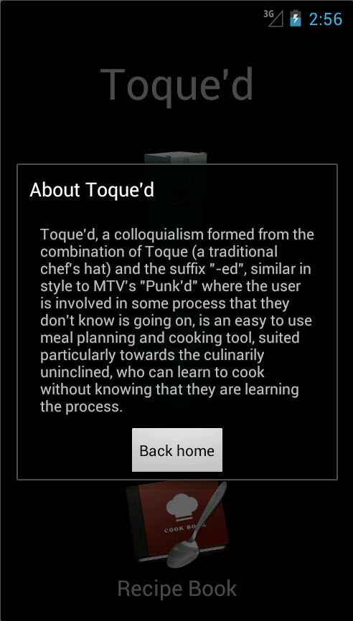
Main Menu

Slide 3
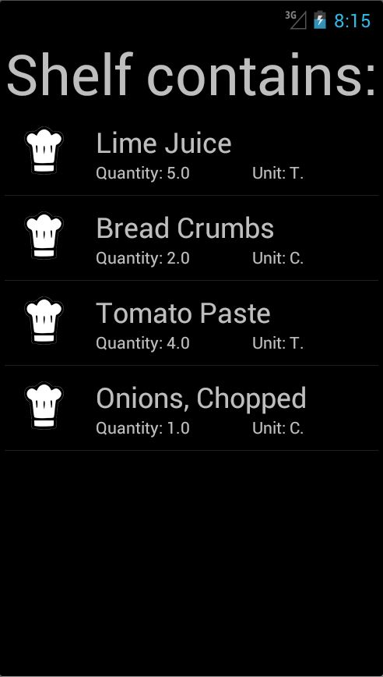
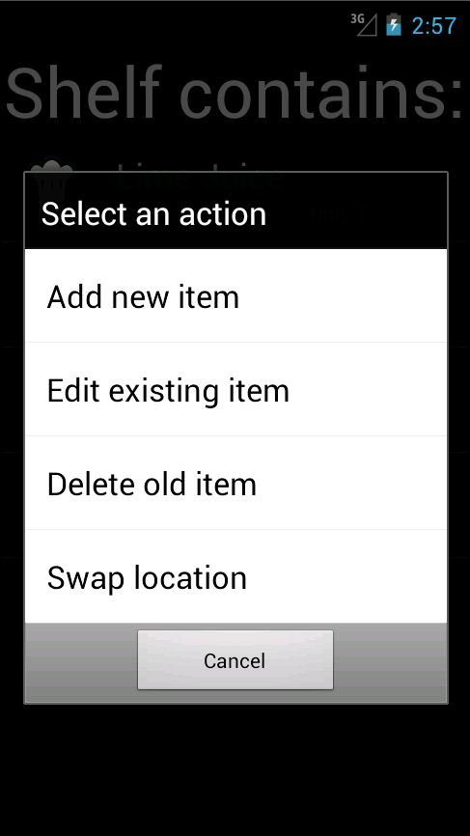
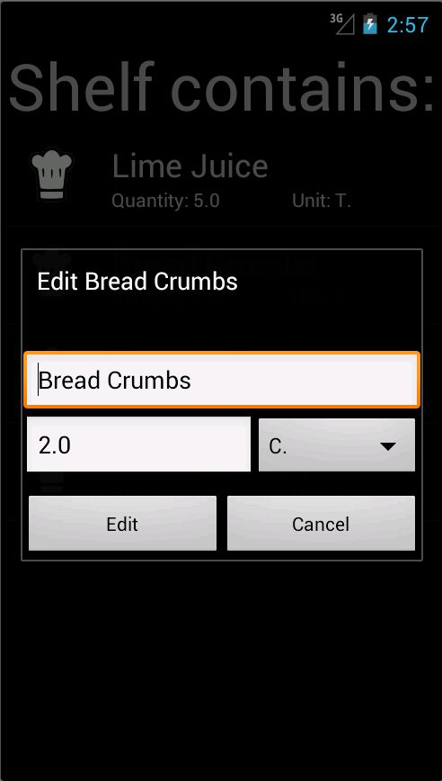
Fridge Menu

Slide 4
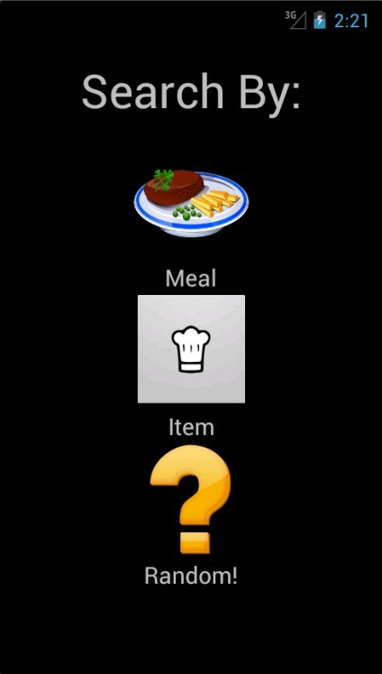
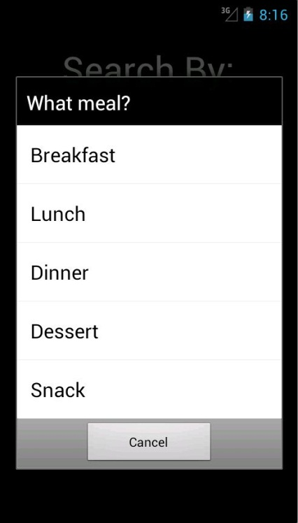
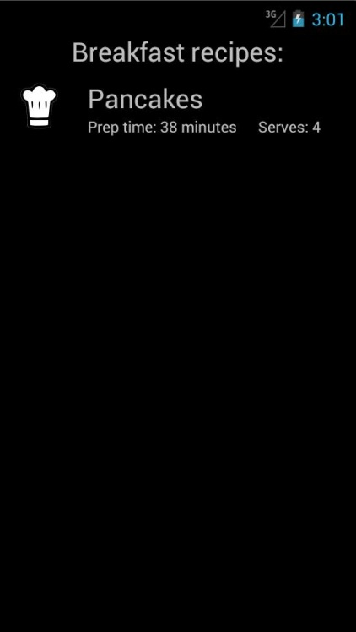
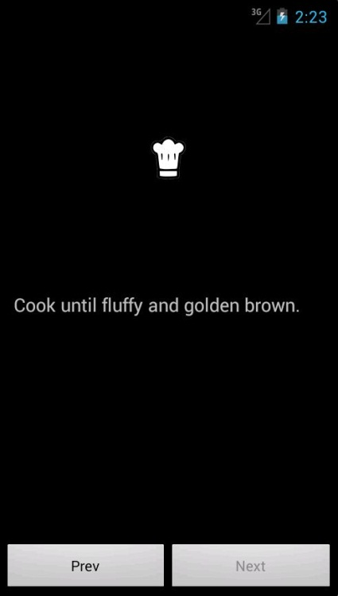
Stove Menu

Slide 5
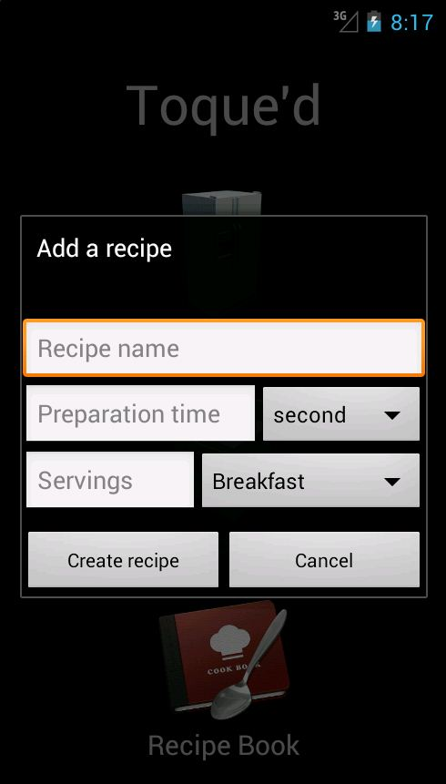
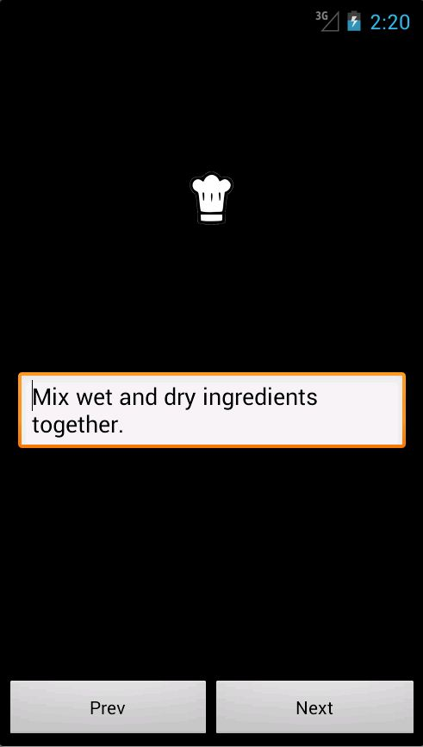
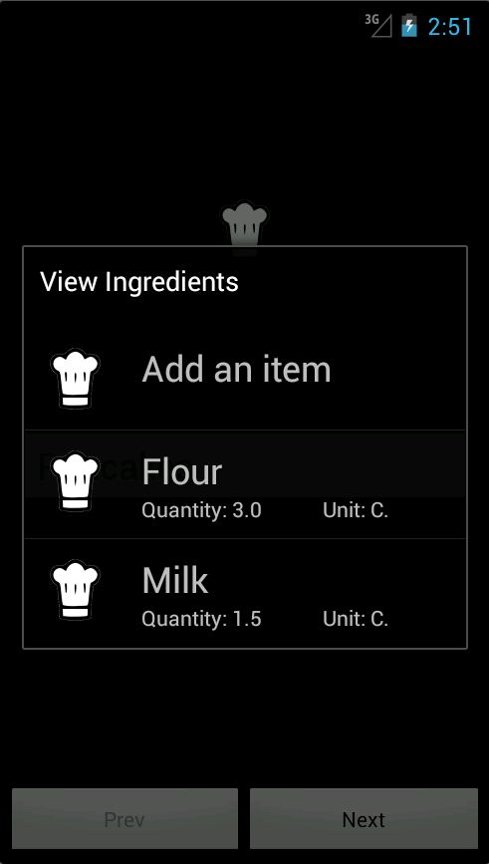
Recipe Book

Slide 6
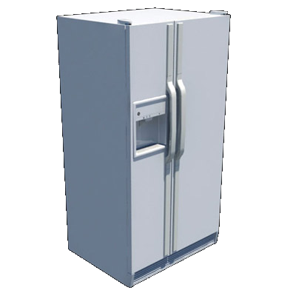
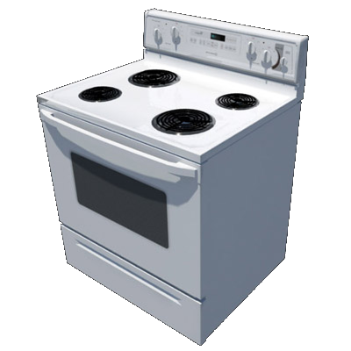

Feature List
Fridge stores items on a shelf, or in a list.
Items have a name, quantity, and unit
Add/Edit/Delete/Swap location
Stove allows users to browse recipes
Can sort by meal, or other characteristics (future).
Random feature!
Recipe Book allows an interface for managing recipes
Recipes have step slides with instructions, and will have pictures (future)
Add/Edit/Delete

Slide 7
Technical Issues
Database issues:
Cursor.moveToNext() moves the cursor as well as returns the object, skipping the first object every time
Cursor.moveToFirst() v.s. moveToLast() depending on how values are added to the system may continuously return the same thing (either the first or last item)
UI issues:
How do you make the app functional AND aesthetically pleasing?
Nested dialogs… not only is the idea potentially confusing for users, the code is hard to read and modify

Slide 8
Future Plans
Better database integration
Integrate items with recipes and populate available recipes based on ingredients present
Allow for recipe filtering based on other criteria (support already exists)
Photographs!
Store as BLOB’s or as string URL’s
Use on board camera (hardware integration)
Share recipes with other users/host recipes online (public API)

